Slide 1
Notes:
*Note to Trainers*
Feel free to add a slide after this one with the name of your clinic, system or hospital to help you personalize the training to your team.

Slide 2
Welcome!
The National HPV Vaccination Roundtable created the HPV Prevention: Nurses Get It Done! toolkit to help nurses at every practice level initiate and complete the HPV vaccination series.
At the core of the toolkit are 3 components that lead to vaccine completion:
Confidently recommend HPV vaccination
Compassionately respond to questions or concerns
Prepare your patient to receive the vaccine
Notes:
**Note to Trainers**
This training is meant to accompany the HPV Prevention: Nurses Get it Done Toolkit.
The toolkit can be downloaded from: https://hpvroundtable.org/getitdone-resources/
If your trainees are following along with a print copy of the toolkit, encourage them to take notes in the toolkit itself. If they do not have the toolkit, consider providing notepaper and pens for notetaking.

Slide 3
Topics for Discussion
Why is HPV vaccination important?
HPV 101 for immunizers
How to talk to parents about vaccination
Managing shot discomfort
Being an HPV Champion
Notes:
**Note for Trainers**
Knowing a little about effective adult learning practices can help make you a more effective teacher.
Adults need to know why they are learning something. The first section, Why is HPV Vaccination Important, addresses that need.
Adults need to learn through doing and problem solving. There are knowledge checks at the end of HPV 101 for Immunizers to provide this type of learning opportunity.
Adults prefer social interaction and the ability to use their life experiences in the classroom. There are opportunities for role-playing and knowledge sharing during the How to Talk to Parents About Vaccination and Managing Shot Discomfort sections.

Slide 4
Why is HPV Vaccination Important?

Slide 5
HPV Vaccination is Cancer Prevention
The HPV vaccine provides safe, effective, and lasting protection against HPV infections that most commonly cause:
Genital warts
HPV-associated cancers of the
Cervix
Vagina
Vulva
Penis
Anus
Oropharynx (base of the tongue and tonsils)
Notes:
HPV Vaccination is cancer prevention!
Only 68% of US teens have received the first dose of the HPV vaccine, and just over ½ are up-to-date on their HPV vaccinations.
The HPV vaccine provides safe, effective, and lasting protection against HPV infections that most commonly cause genital warts and high-grade precursors and cancer.

Slide 6
The Power of Nurses at All Practices Levels
Critical members of the immunization team
Powerful role in shared-decision making regarding HPV vaccination initiation and completion
The National HPV Vaccination Roundtable
Nurses are powerful change agents
HPV Prevention: Nurses Get It Done! Toolkit
Created to educate and empower nurses to confidently recommend HPV vaccine initiation and completion
Notes:
Nurses at all practice levels have long been advocates for vaccination and have done an incredible amount of work to protect patients from vaccine-preventable diseases, but there is more work to do to increase HPV vaccination rates.
The National HPV Vaccination Roundtable created the “HPV Prevention: Nurses Get It Done Toolkit” to:
Increase your knowledge about the HPV vaccine
Learn how to make a strong recommendation for HPV vaccination
Get tips on how to prepare patients to receive the vaccine.

Slide 7
HPV 101 for Immunizers

Slide 8
Notes:
**Note to Trainers**
Let members of your clinical team know that the information provided in this training is a detailed overview of the science and if they would like more information to check out the CDC’s Pink Book chapter on HPV.

Slide 9
What is Human Papillomavirus (HPV)?
Common virus can → 6 types of cancers later in life
More than 200 related viruses
Types
Cutaneous HPV types: Cause warts on the skin (arms, hands, and feet)
Mucosal HPV types: Categorized according to their association with cancer
Oncogenic (High-risk types HPV 16 and 18) can cause cancer
Non-oncogenic (Low-risk types HPV 6 and 11) can cause:
Genital warts
Benign or low-grade cervical cell changes
Recurrent respiratory papillomatosis (RRP)
Notes:
HPV, or human papillomavirus, is a common virus that can lead to 6 types of cancers later in life.
HPV is a group of more than 200 related viruses.
HPVs are called papillomaviruses because some HPV types cause warts or papillomas.
Most HPV types are called cutaneous because they cause warts on the skin – often on the arms, chest, hands and feet. These are common warts. The other 25% of HPV types are considered mucosal types of HPV.
Mucosal HPV types invade and live in cells on mucosal surfaces such as: the vagina, cervix, vulva, anus, inner foreskin and urethra of the penis, the inner lining of the nose, mouth, and throat, the trachea and bronchi, and the inner eyelids.
Mucosal HPV types are categorized according to their association with cancer. High-risk types (e.g., types 16 and 18) can cause cancer. Low-risk types, including types 6 and 11, can cause genital warts, benign or low-grade cervical cell changes, and recurrent respiratory papillomatosis (RRP).

Slide 10
How Many Cancers are Caused by HPV?
An HPV infection can cause 6 different kinds of cancers affecting nearly 35,000 US women and men, annually
Cancer Site | % Probably Caused by Any HPV Type | Estimated Number Probably Caused by Any HPV Type
Cervix | 91% | 10,900
Vagina | 75% | 600
Vulva | 69% | 2,800
Penis | 63% | 800
Anus | 91% | 6,200
Oropharynx | 70% | 13,500
https://www.cdc.gov/cancer/hpv/statistics/cases.htm
Notes:
An HPV infection can cause six kinds of cancers affecting nearly 35,000 men and women in the United States each year.
In general, HPV is thought to be responsible for more than 90% of anal and cervical cancers, about 70 - 75% of vaginal and vulvar cancers, and 63% of penile cancers.
Oropharyngeal cancers traditionally have been caused by tobacco and alcohol, but studies show about 60 – 70% of cancers of the oropharynx may be linked to HPV.
Though HPV is typically associated with cervical cancer, there are more HPV-associated oropharyngeal cancers diagnosed each year than cervical cancers and most are diagnosed in men. Currently, there is no screening test for oropharyngeal cancers. The HPV vaccine is the best line of defense against these cancers for men and women.

Slide 11
How Does the HPV Vaccine Work?
Made from virus-like particles (VLPs) that look like the outside of the actual human papillomavirus
Antibodies develop in response to VLPs
Antibodies prevent the HPV virus from entering cells → infection → disease → cancer
Gardasil® 9 helps the body create antibodies against 9 different HPV types:
High-risk types 16, 18, 31, 33, 45, 52 and 58
Low-risk types 6 and 11
The HPV vaccine does not contain any live virus, killed virus, or even DNA from the virus, so it cannot cause cancer or other HPV-related illnesses.
Notes:
The HPV vaccine is made from virus-like particles (VLPs) that look like the outside of the actual human papillomavirus (HPV).
The vaccine does not contain any live virus, killed virus or even DNA from the virus, so it cannot cause cancer or other HPV-related illnesses.
When the HPV vaccine is given, the body makes antibodies in response to the VLPs to clear them from the body. If a person is then exposed to a real HPV virus, the same antibodies can prevent it from entering the cells of the body and creating an infection.
Gardasil® 9, the only HPV vaccine currently available for use in the United States, helps the body create antibodies against nine different HPV types.
Gardasil® 9 protects against high-risk HPV types 16 and 18, the two types that cause 70% of cervical cancers and precancerous lesions, and HPV types 6 and 11, which cause most genital warts.
Gardasil® 9 also protects against the high-risk types 31, 33, 45, 52 and 58. (14, 15)

Slide 12
How Effective is the HPV Vaccine?
Provides almost 100% protection from targeted HPV types if all doses are received at the correct intervals and if administered before exposure
Since 2006, vaccine-type HPV infections have decreased:
78% in US women ages 20 – 24
38% in US women for ages 25 – 29
Recent studies demonstrate protection against HPV-related pre-cancers and cancers:
51% reduction in CIN2+ among women ages 15 – 19
31% reduction in CIN2+ among women ages 20 – 24
(1) Markowitz LE, et al. Declines in HPV Vaccine Type Prevalence in Women Screened for Cervical Cancer in the United States: Evidence of Direct and Herd Effects of Vaccination. Vaccine. 2019. (2) Drolet M, et al. Population-Level Impact and Herd Effects Following the Introduction of Human Papillomavirus Vaccination Programmes: Updated Systematic Review and Meta-Analysis. Lancet. 2019.
Notes:
The HPV vaccine is highly effective.
The HPV vaccine provides almost 100% protection from targeted HPV types if all doses are received at the correct intervals and if it is given before exposure.
All HPV vaccines were found to provide nearly 100% protection against persistent cervical infections with HPV types 16 and 18 and the cervical cell changes these persistent infections can cause. Gardasil® 9 was found to be nearly 100% effective in preventing cervical, vaginal, and vulvar disease caused by the five additional HPV types (31, 33, 45, 52, and 58) that it targets.
Since the introduction of the HPV vaccine:
• Infections with HPV 16 and 18 decreased by 83% among girls aged 15–19 years and by 66% among women aged 20–24 years.
• Diagnoses of anogenital warts decreased by 67% among girls aged 15–19 years and by 54% among women aged 20–24 years.
• The prevalence of precancerous lesions that can lead to cervical cancer decreased by 51% among girls aged 15–19 years and by 31% among women aged 20–24 years.
The HPV vaccine is also effective in preventing anal cell changes caused by persistent infection and genital warts.

Slide 13
Is the HPV Vaccine Safe?
Yes! All vaccines used in the US, are required to go through years of extensive safety testing before licensure
Review of 109 studies found no significant increases in adverse events
Over 270 million doses have been given worldwide and common side-effects include:
Pain
Redness or swelling at the injection site
Headache
Nausea
Dizziness
Fainting after getting a shot is more common in teens than in young children.
Patients should remain seated for 15 minutes after vaccination.
Arbyn M, Xu L. Efficacy and Safety of Prophylactic HPV Vaccines. A Cochrane Review of Randomized Trials. Expert Rev Vaccines. 2018;17(12):1085-1091.
Notes:
Yes.
All vaccines used in the United States, including the HPV vaccine, are required to go through years of extensive safety testing before they are licensed by the U.S. Food and Drug Administration (FDA). As with all approved vaccines, the CDC and the FDA continuously monitor the safety of HPV vaccines after they are licensed. The most recent safety data review for HPV vaccines continue to show that these vaccines are safe.
Common side effects are mild and include pain, redness or swelling in the arm where the shot was given, headache, nausea and dizziness. Fainting (syncope) after getting a shot is more common in teens than in young children or adults. Just as medical procedures such as drawing blood can make you feel faint, injections – including vaccinations – can make people feel dizzy. To keep people from getting hurt from fainting, patients should be seated or lying down during treatment and remain in that position for 15 minutes after the vaccine is given.

Slide 14
When is the Right Time to Vaccinate?
Recommended for all 11-12 year old adolescents, but HPV series can be started as early as age 9 (On-time vaccination)
Also recommended for males and females age 13 – 26 who have not been vaccinated previously or who have not completed the vaccination series (Catch-up vaccination)
Works best when given before age 13 as cancer protection decreases as age at vaccination increases
Notes:
CDC recommends routine HPV vaccination for all adolescents at age 11 or 12 years of age but the series can be started at 9 years of age.
Vaccination is also recommended for males and females age 13 through 26 who have not been vaccinated previously or who have not completed the vaccination series.28
HPV vaccination works best when given before age 13.
Cancer protection decreases as age at vaccination increases. Although the vaccine has been approved by the FDA for males and females through age 45, the Advisory Committee on Immunization Practices (ACIP) does not recommend routine vaccination of people older than 26. Instead, they recommend shared clinical decision making for adults who were not previously vaccinated.
For people 27 to 45 years old who have not started the vaccines or who have started but not completed the series, it’s important to know that vaccination at older ages is less effective in lowering cancer risk.

Slide 15
How Long Will the Vaccine Prevent HPV Infections?
Studies suggest that HPV vaccines offer long-lasting protection against infection, disease, and cancer
Continued protection against high-grade cervical, vaginal, and vulvar neoplasia has been observed through at least 10 years following vaccination
Notes:
Studies suggest that HPV vaccines offer long-lasting protection against HPV infection and, therefore, the disease caused by HPV infection.
Continued protection against high-grade cervical, vaginal and vulvar neoplasia has been observed through at least 10 years following vaccination, and persistent antibody levels and protection against HPV infection have also been reported up to 10 years following vaccination.
Duration of protection provided by HPV vaccination will continue to be studied and experts expect protection will last much longer.

Slide 16
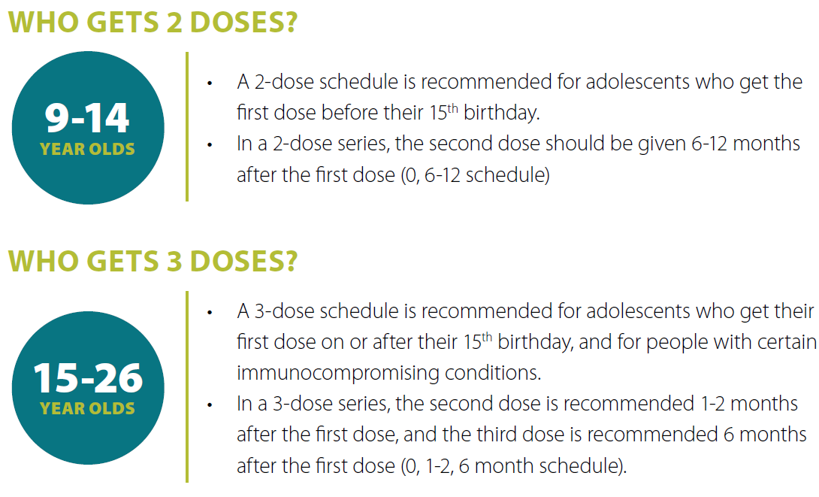
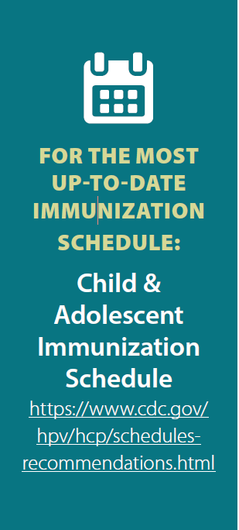
What is the HPV Vaccine Dosing Schedule?
Notes:
The CDC recommends routine HPV vaccination for all adolescents at age 11 or 12 years of age but the series can be started at 9 years of age.
When given at the recommended age, patients will need fewer doses to be protected. On-time vaccination = FEWER doses in the series.
Adolescents need 2 or 3 doses depending on age at initial vaccination.
2-DOSE SCHEDULE: Recommended for adolescents who get the first dose before their 15th birthday.
The second dose should be given 6-12 months after the first dose (0, 6-12 schedule)
3-DOSES SCHEDULE:
Recommended for adolescents who get their first dose on or after their 15th birthday, and for people with certain immunocompromising conditions.
The second dose is recommended 1-2 months after the first dose, and the third dose is recommended 6 months after the first dose (0, 1-2, 6 month schedule).
The HPV vaccine can be administered safely at the same visit as other vaccines recommended for adolescents at ages 11 or 12 years, such as tetanus toxoid, reduced diphtheria toxoid and acellular pertussis (Tdap) vaccine; quadrivalent meningococcal conjugate (MenACWY) vaccine; and influenza vaccine.

Slide 17
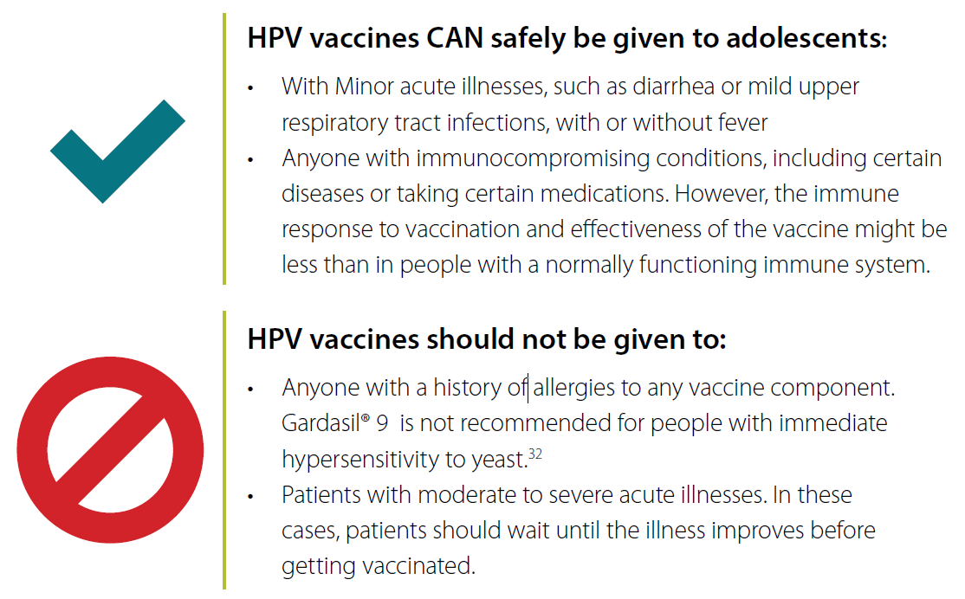
The HPV vaccine can be given at the same visit as out routinely recommended vaccines.
Notes:
HPV vaccines CAN safely be given to adolescents:
With Minor acute illnesses, such as diarrhea or mild upper respiratory tract infections, with or without fever
Anyone with immunocompromising conditions, including certain diseases or taking certain medications. However, the immune response to vaccination and effectiveness of the vaccine might be less than in people with a normally functioning immune system.
HPV vaccines should not be given to:
1. Anyone with a history of allergies to any vaccine component. Gardasil® 9 is not recommended for people with immediate hypersensitivity to yeast.
2. Patients with moderate to severe acute illnesses. In these cases, patients should wait until the illness improves before getting vaccinated.

Slide 18
HPV 101 for Immunizers Knowledge Check
Q: Persistent HPV infection has been linked to cancers in which anatomical sites?
Cervical
Cervical and anal
Cervical, anal, and oropharyngeal
Cervical, anal, oropharyngeal, vaginal, vulvar and penile
Notes:
**Note to Trainers**
Use these knowledge checks as interactive learning opportunities during your training. Consider having trainees write down the answers on their own and give small rewards for the most correct answers. Or, you can have them answer as a group. The goal of this knowledge check is to ensure that people fully understand the information presented in this section.

Slide 19
HPV 101 for Immunizers Knowledge Check
True or False: 270 million doses of HPV vaccine have been distributed worldwide since vaccine licensure.
True
False

Slide 20
HPV 101 for Immunizers Knowledge Check
Q: How effective is Gardasil®9 for prevention of HPV infections, disease, and cancers caused by the targeted nine HPV types?
0% effective
20% effective
50% effective
Nearly 100% effective

Slide 21
HPV 101 for Immunizers Knowledge Check
Q: The HPV vaccine can be safely administered to adolescents presenting with:
Mild upper respiratory infection
Mild illness with fever
Mild illness without fever
Immunocompromising conditions
All of the above

Slide 22
HPV 101 for Immunizers Knowledge Check
Q: In order to complete the HPV vaccination series, how many doses are needed if the HPV vaccine is administered between the ages of 9 -14?
one
two
three

Slide 23
How to Talk to Parents about Vaccination

Slide 24
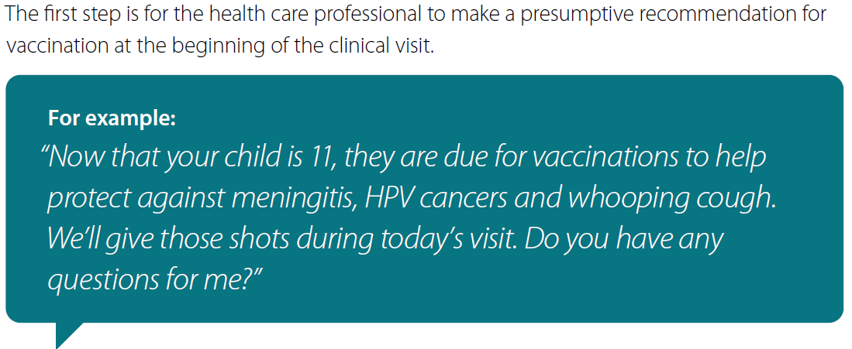
Make a Strong Presumptive Recommendation
Notes:
The first step in increasing vaccination rates is for the health care professional to make a presumptive recommendation for vaccination at the beginning of the clinical visit. A presumptive recommendation PRESUMES the parent will accept vaccination.
“Now that your child is 11, they are due for vaccinations to help protect against meningitis, HPV cancers, and whooping couch. We’ll give those shots during today’s visit. Do you have any questions for me?”
Some parents might have concerns or questions even after a health care professional makes a strong recommendation. If parents ask you questions about HPV vaccination, it is important to remember that the questions are coming from a place of love and concern for their child. They are not questioning your expertise or the health care provider’s expertise. Most parents want reassurance from you that vaccination is the right decision for their child. If you do get a difficult question, the following slides present a simple 3-step plan to help you address their concern/s.

Slide 25
Responding to Questions
If a parent asks you a question about HPV vaccination, it is important to remember that they are asking from a place of love and concern for their child
Follow these 3 steps when answering questions.
BREATH- Actively listen and understand your parent’s question.
ANSWER- ONLY respond to the question. Refrain from giving overwhelming information
CLOSE WITH CONFIDENCE- Make a strong recommendation
Notes:
Parents ask questions about HPV vaccination from a place of love and concern for their child.
Follow these 3 steps when answering their questions.
First, Breathe. actively listen to clearly understand parents concerns. Your answer should sound calm and confident.
Second, Answer. Respond to the question at hand, refrain from overloading parents with overwhelming facts.
Third close with confidence.
For example “The first priority in our office is your child health, that’s why we strongly recommend getting the HPV vaccine today.”

Slide 26
Key Messages for Parents
Q: Why is the HPV vaccine important?
HPV vaccination is cancer prevention
HPV infection is very common and most people (4 out of 5) will be infected in their lifetime
Most HPV infections go away on their own but some persist and cause cancer
When the HPV vaccine is given at the recommended ages, it can help protect against certain HPV cancers later in life
Notes:
HPV vaccination is cancer prevention.
HPV infection is very common; most people (about 4 out of 5) will be infected with HPV in their lifetime.
Most HPV infections go away on their own, but some persist and cause cancer. There is no way to know if an HPV infection will lead to cancer.
Over 35,000 people in the U.S. get HPV cancers each year.
When the HPV vaccine is given at the recommended ages, it helps to protect against certain HPV cancers later in life.
*Note to Trainer**
The toolkit contains links to other resources for each key message. Encourage your trainees to visit these resources for more information.

Slide 27
Key Messages for Parents
Q: Is the HPV vaccine safe?
Studies continue to show the HPV vaccine is very safe
270 million doses have been given around the world
Most common side effects are mild → include soreness or swelling at the injection site
Preteens are more likely to faint when given injections so make sure they stay seated for 15 minutes after administration
Notes:
The HPV vaccine is very safe.
270 million doses have been distributed around the world and the most common side effects are mild including soreness or swelling where we give the injection.
HPV vaccination is continually monitored for safety both in the U.S. and around the world.
Just as medical procedures make some people feel faint, sometimes the vaccine can make you feel faint. We will have you stay here for 15 minutes, If you feel light headed or dizzy let me know.

Slide 28
Key Messages for Parents
Q: Why are you vaccinating my child at this age?
Vaccines = PREVENTION
Given during the preteen years (on-time) to protect children long before exposed to the virus
HPV vaccine is routinely recommended for boys and girls at ages 11-12 and can be started at age 9
Waiting until kids are older to initiate (catch-up) means an additional dose/shot and possibly reduced cancer prevention
Notes:
All vaccination is provided to prevent future infection. We give the HPV vaccine during the preteen years to protect children long before they are exposed to the virus.
HPV vaccination is routinely recommended for boys and girls at ages 11-12 and can be started at age 9.
The vaccination produces such a good immune response in younger adolescents that only two doses are needed.
Waiting until kids are older to start the HPV vaccine series will mean an extra shot and possibly reduced cancer prevention.

Slide 29
Key Messages for Parents
Q: Does HPV vaccination increase my child’s desire to have sex?
No. Studies have shown that getting the HPV vaccine does not result in kids starting to have sex earlier
Most people will be exposed to HPV at some time in their life
Vaccinating now can help protect your child into adulthood
Notes:
No, studies have shown that getting the HPV vaccine does not result in children starting to have sex earlier.
Most people will be exposed to HPV at some time in their life.
Vaccinating now can help protect your child into adulthood.

Slide 30
How to Avoid Long Conversations
Some parents might have a lot of questions, even after receiving a strong recommendation from a provider
3-step process to help manage long conversations:
Answer up to three questions
Give them time
Make an appointment
Notes:
You’ve made a strong presumptive recommendation and you’ve answered one or two questions and the parent still has concerns or questions.
If a parent has several questions, you can use the following process to help manage the conversation.
This process should only take a few minutes.

Slide 31
How to Avoid Long Conversations
Notes:
Step 1: Answer Up to Three Questions
Keep your responses short, succinct, and direct.
Applying motivational interviewing techniques may be helpful to understand a parent’s underlying concerns.
Once you understand their core concerns, use the key messages to address them.
**Note to Trainers**
The toolkit contains a link to a Motivational Interviewing resource: https://www.immunizecolorado.org/uploads/Motivational-Interviewing-slides.pdf
You may want to show this video describing Motivational Interviewing in the context of vaccination if there is time: https://www.youtube.com/watch?v=yZ6vL7s1tZ0

Slide 32
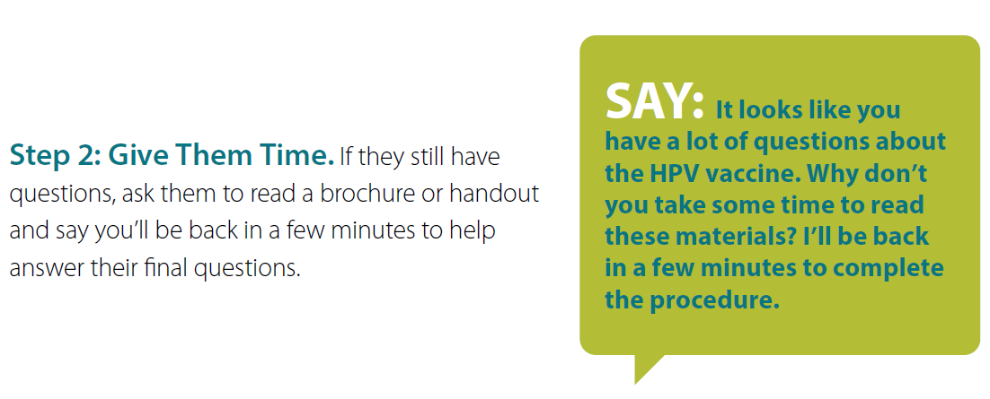
How to Avoid Long Conversations
Notes:
Step 2: Give Them Time.
If they still have questions, ask them to read a brochure or handout and say you’ll be back in a few minutes to help answer their final questions.

Slide 33
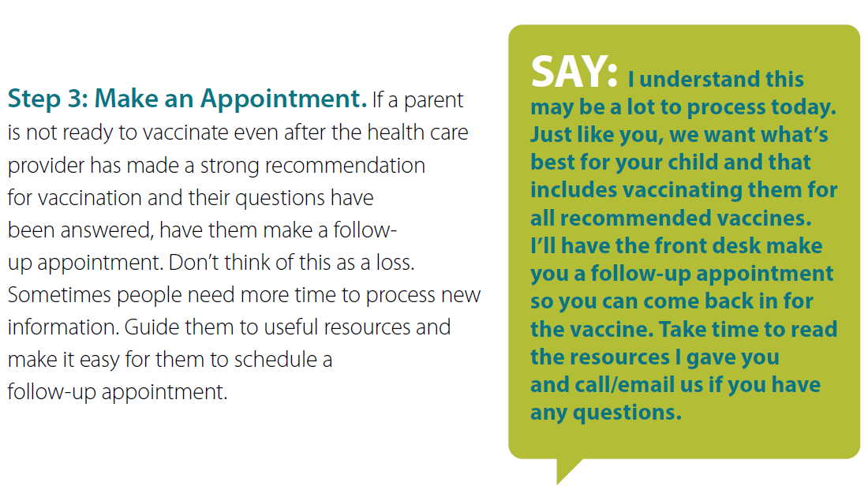
How to Avoid Long Conversations
Notes:
Step 3: Make an Appointment.
If a parent is not ready to vaccinate even after the health care provider has made a strong recommendation for vaccination and their questions have been answered, have them make a follow-up appointment.
Don’t think of this as a loss.
Sometimes people need more time to process new information. Confirm that you will address this again at the next visit
Guide them to useful resources and make it easy for them to schedule a follow-up appointment.

Slide 34
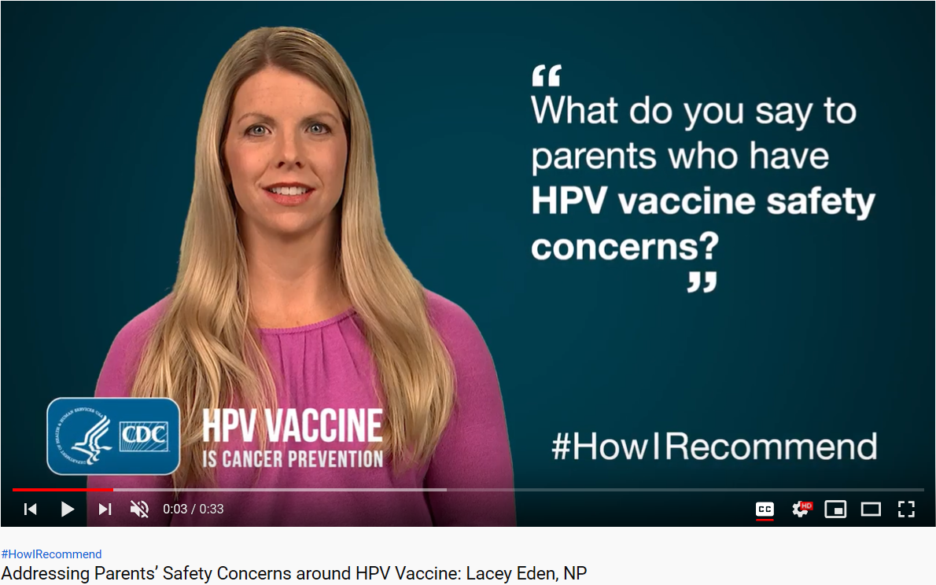
Talking About the HPV Vaccine Knowledge Check:
#HowIRecommend
See how other health care professionals recommend HPV vaccination and answer questions from parents.
https://www.cdc.gov/vaccines/howirecommend/adolescent-vacc-videos.html
Notes:
See how other health care professionals recommend HPV vaccination and answer questions from parents.
Check out CDC’s #HowIRecommend video series at https://www.cdc.gov/vaccines/howirecommend/adolescent-vacc-videos.html

Slide 35
Talking About the HPV Vaccine Knowledge Check
What questions have parents asked you about the HPV vaccine? How did you feel when they asked you the question? Would you change anything about your answer?
Spend some time practicing how you might respond to a parent with the following questions:
Why is the HPV vaccine important?
How do we know the HPV vaccine is safe?
Notes:
*Note to Trainers*
Its important to have a conversation with your office staff about the information provided. Open the discussion by asking them about their experiences answering parents questions about HPV vaccine.
Give your staff an opportunity to role play by dividing into groups. Have one person act as the parent and ask 1. Why is the HPV vaccine important? Have the other nurse practicing responding to this questions.

Slide 36
Managing Shot Discomfort

Slide 37
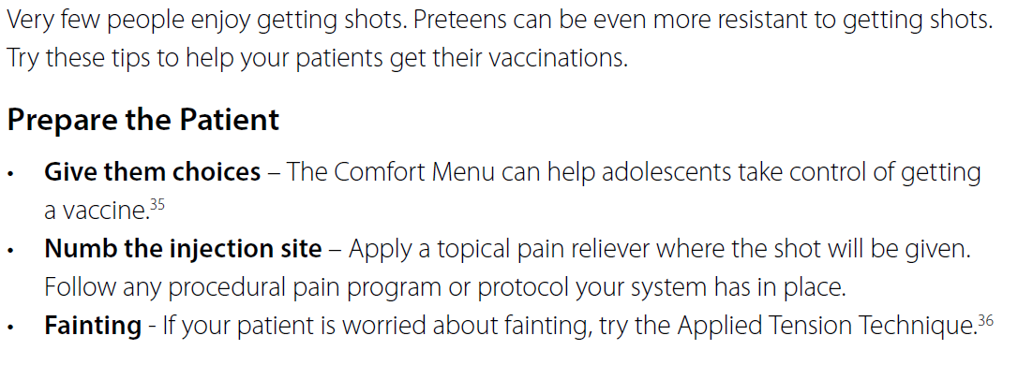
How to Manage “Shot Aversion”
Notes:
Research from the National Institutes of Health shows children with high fear of needles were 2.5 times less likely to start their HPV series than those with low fear.34
Give them choices helps the adolescent feel in control. Give them some options and ask what they would like to do. For example you can recommended distraction techniques like playing a game on their phone or listening to music. Offer topical pain reliever. Discuss the Applied Tension technique to help reduce fainting by teaching them to tension all their muscles for 10 seconds then relax.
Fear of needles and shots is a barrier to health and people are more afraid of getting shots than ever before.
*Note to Trainers*
Links to The Comfort Menu and Applied Tension Technique can be found on page 15 of the toolkit.

Slide 38
How to Manage Injection Pain
Order matters – Administer vaccines in the order of increasing painfulness; most painful vaccine administered last
Breathe – Breathe all the way down into their belly; deep breathing can help people relax
Do not aspirate – Aspiration not necessary for intramuscular injections and may increase pain
Relax – Have your patient shake out their arm and work on relaxing their arm muscles
Look Over There! – Have your patient look the opposite way from the arm you are injecting
Distract with a conversation or device – Talk throughout the procedure or ask them to listen to music or play a game on a device
Notes:
Manage Pain
Order matters - Some vaccines are more painful than others. Vaccines should be administered in the order of increasing painfulness, with the most painful vaccine administered last.
Breathe - Ask your patient to breathe all the way down into their belly. Deep breathing can help people relax.
Do not aspirate - Aspiration is not necessary for intramuscular injections and may increase pain.
Relax – Have your patient shake out their arm and work on relaxing their arm muscles.
5. Look over there! – Anticipation is half the battle with getting a shot. Have your patient look the opposite way from the arm you are injecting.
Distract with conversation or a device - Talk to the patient through the whole procedure. Ask them about their favorite show, favorite sport or anything other than getting a shot. Or ask the preteen to listen to music or play a game on a device like a smartphone or a tablet.
7. Cough - Research shows that coughing once before and once during the shot can help some people feel less pain.

Slide 39
Managing Shot Discomfort Knowledge Check
How do you manage “shot aversion” in your practice?
What are effective ways you help manage injection pain for your patients?
Notes:
*Note to Trainers*
Open up for discussion. Ask how shot aversion is addressed in the office, ideas for improvement, and discuss possible ways to improve pain management for vaccines in your office.

Slide 40
Be an HPV Vaccine Champion

Slide 41
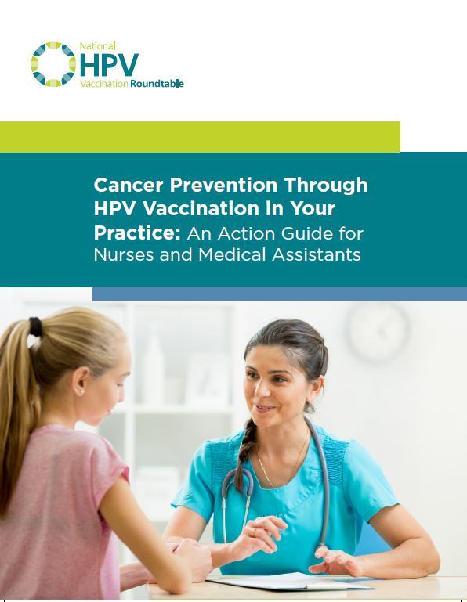
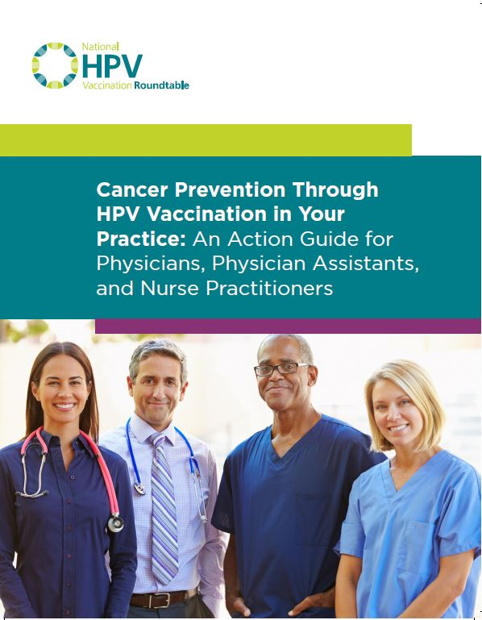
Be An HPV Vaccine Champion!
For more tips and resources on how to be an HPV vaccine champion, download the relevant HPV Vaccination Roundtable Action Guide at https://hpvroundtable.org/action-guides/
Notes:
The National HPV Vaccination Roundtable has created several resources for nurses, medical assistants, physicians, physician assistants and nurse practitioners. These action guides are available to download for free and contain additional evidence-backed practices you can take right now to help increase HPV vaccination rates in your office, clinic or system.

Slide 42
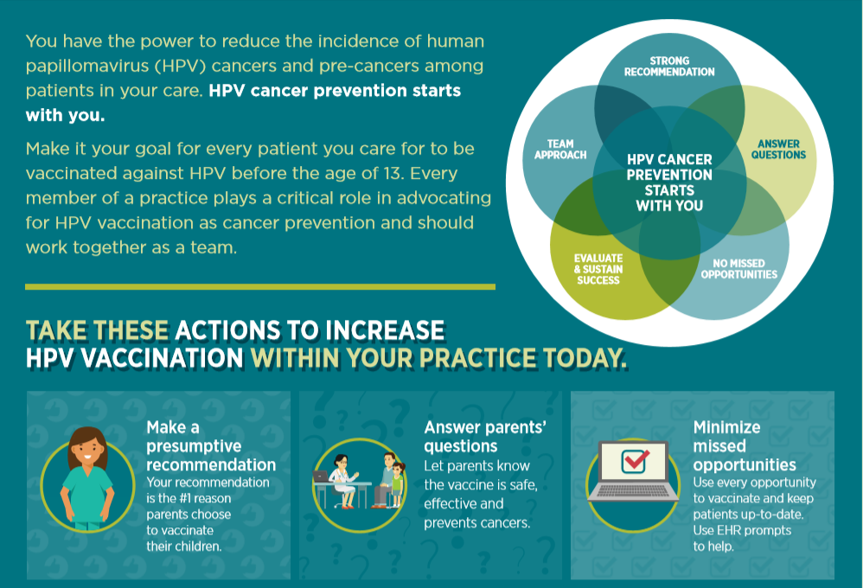
Nurses GET IT DONE when it comes to vaccinations
Notes:
You have the power to reduce HPV cancers. Set goals to talk with every parent of adolescent children about HPV vaccine. Lead your office team as the HPV vaccine champion by creating checklists or EHR reminders to make a presumptive recommendation for every patient by 13 years of age. Continue to practice how to answer questions regarding HPV vaccine .

Slide 43
Notes:
*Note to Trainer*
Once the nurses and staff have completed the toolkit training provide them with a certificate of achievement. Encourage everyone who has earned the certificate to post next to their station in the clinic. Or create a HPV champion wall and post certificates, choose a “Champion of the Month” and place their photo and the certificate in the lobby.

Slide 44
Get Social
Let us know you GET IT DONE with #HPVprevention and #2shots2stopCancer on social media.
Facebook HPV Cancer Free Facebook Group - https://www.facebook.com/groups/HPVCancerFreeFamily/
Nurses Who Vaccinate Facebook Group - https://www.facebook.com/groups/NursesWhoVaccinate/
National HPV Vaccination Roundtable Twitter -https://twitter.com/hpvroundtable
National HPV Vaccination Roundtable Instagram - https://www.instagram.com/hpv.vaccination.roundtable/
Notes:
*Note to Trainer*
The HPV Roundtable would like to know how you are “GETTING IT DONE!”
Brainstorm with your trainees how you can share your success stories on social media with the hashtags #HPVprevention and #2shots2stopcancer.
Also, discuss if you can share HPV vaccine champion messages on your offices social media sites.

Slide 45
Questions? Comments? Contact: HPV.Vaccination.Roundtable@cancer.org
Notes:
*Note to Trainer*
Allow time for questions and discussion. Recap any tips or lessons that were shared by trainees. Great an expectation to share back in a few weeks time how trainees are using what they learned.
If there are questions you don’t have the answer to, feel free to reach out to the HPV Roundtable and we will gladly help.

