Slide 1
Approved Expansion of HPV Vaccination to Age 45: What Does It Mean?
Debbie Saslow, PhD │ Senior Director, HPV-related and Women’s Cancers, American Cancer Society
& Vice Chair, National HPV Vaccination Roundtable
Rebecca Perkins, MD, MS│ Associate Professor of Obstetrics and Gynecology, Boston University
School of Medicine/Boston Medical Center
Funding for this webinar was made possible (in part) by the Centers for Disease Control and Prevention Cooperative Agreement grant number NH23IP922551-03, CFDA # 93.733. The content in the guide (or ) does not necessarily reflect the office policies of the Department of Health and Human Services, nor does the mention of trade names, commercial practices, or organizations imply endorsement by the U.S. Government.

Slide 2
FDA: Approves vaccines
ACIP: Recommends vaccination

Slide 3
FDA Approval is based on:
Safety
Efficacy (in a clinical trial setting)
ACIP Recommendation also considers:
Disease burden
Effectiveness (in a real world setting)
Cost-effectiveness
Notes:
FDA

Slide 4
Safety & Immunogenicity
Immunogenicity and safety are similar in mid-adults compared to older adolescents and young adults

Slide 5
Efficacy
the percent reduction in disease incidence in a vaccinated group compared with an unvaccinated control group under experimental conditions
Example conditions: ≤6 lifetime sex partners, no HPV or antibodies detected
vs. Effectiveness
the reduction in disease outcomes in a “real world” setting
Notes:
vs. Effectiveness

Slide 6
Timeline
October 5th, 2018: FDA approved Gardasil 9 for men and women ages 27-45 years
October 25th, 2018: ACIP presentations on evidence, cost-effectiveness, potential impact, and policy options
February 27-28, 2019: ACIP presentations on additional evidence and economic analysis, potential vote

Slide 7
Evidence: Efficacy--Merck Study (V501-019)
3,817 women: half received qHPV vaccine, half placebo
PPE: seronegative at Day 1, DNA negative through Month 7
Median number of lifetime sexual partners: 2 (max 6)
1,189 of the vaccinated women in Colombia were followed for up to 10 years (n=600) or 5 years (n=589)
Endpoints: genital warts, CIN (any grade)
Endpoint @3.8 yrs | Cases/women vax | Cases/women placebo | Efficacy (95% CI)
≥ CIN2 PPE | 1/1581 (0.06%) | 6/1584 (0.38%) | 83.3% (-37.6, 99.6)
≥ CIN2 ITT* | 21 | 27 | 22.4% (-42.5, 58.3)
Castellsague et al, Br J Cancer 2011; 105:28-37
Notes:
PPE: per protocol efficacy
Vs
ITT: intention to treat
ITT imbalance at baseline, but: efficacy against the incidence of abnormal Pap smears related to HPV 16 or 18 was 96.3% (95% CI: 77.7, 99.9) in the PPE population and 47.5% (95% CI: 16.9, 67.4) in the ITT population

Slide 8
Evidence: Effectiveness Studies
11 published studies from 6 countries
Endpoints: CIN2+ (4), genital warts (5), HPV infection (2)
Effectiveness decreased as age of vaccination increased in all studies
In 7 studies: no significant effectiveness in oldest age group (usually vaccination in low to mid 20’s)
In 4 studies, some significant effectiveness in oldest age group, e.g. 20-29 (22% effective for CIN2+)
Data support importance of vaccination by age 13

Slide 9
New Evidence on Risk of Infection
About 1/3 of HPV infections in mid-adult women are due to new infections rather than reactivation of latent infections
For women with new partners, most newly detected HPV was caused by a new infection, so…
For individual decision making, the biggest risk factor is a new sexual partner
Notes:
% of men and women with 1 or more new partners in the last year highest among unmarried/not living with a partner, and decreases with age

Slide 10
Cost-Effectiveness
Preliminary!!
3 health economics models
Vaccination of early adolescents is cost-SAVING
Cost-effectiveness decreases as age of vaccination increases

Slide 11
Burden of Disease
Based on preliminary modeling
Cancers prevented by vaccinating to age 45 compared to age 26: 50 cases of cervical cancer + 80 cases of other cancers per year
This is an additional 0.9% over vaccinating to age 26
[Vaccinating to age 26 prevents about 1.3% additional cancers over vaccinating to age 21]

Slide 12
Policy Options/Potential New Recommendation
Routine vaccination: no change
Catch-up vaccination: no change OR harmonize male/female OR change age range of catch-up
Individual decision-making for some group of mid-adults, e.g. 27-45, which would require:
Guidance on who might benefit
Communication about assessing risk, potential benefit, and lower effectiveness
Avoiding a return to risk assessment/messages about sex with pre-teens and teens
Notes:
Note: this was presented as discussion from the ACIP HPV work group
Note: increasing age of male vax to 26 in order to harmonize is NOT cost-effective but addresses programmatic challenges
Note: last bullet is MINE, not ACIP

Slide 13
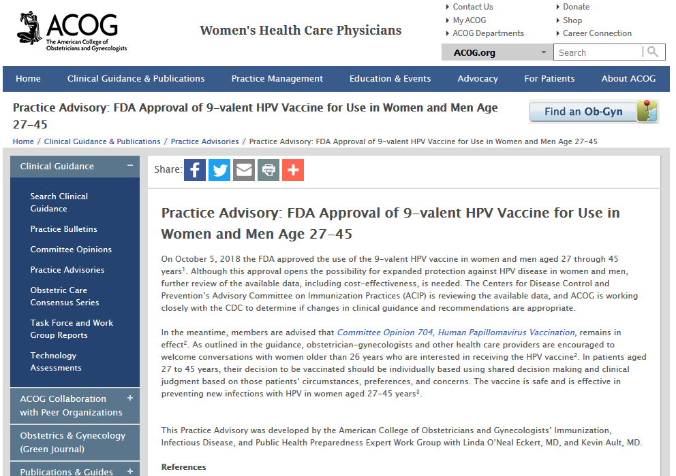
In patients aged 27 to 45 years, their decision to be vaccinated should be individually based using shared decision making and clinical judgment based on those patients’ circumstances, preferences, and concerns. The vaccine is safe and is effective in preventing new infections with HPV in women aged 27-45 years.

Slide 14
People want to know…
Is it safe?
Does it work?
Will my insurance pay for it?

Slide 15
HPV vaccination is safe for all ages
Common side effects are a sore arm, and occasionally short-term fever or headache, similar to other vaccines
No serious side effects have been reported caused by the vaccine for kids or adults
Castellsague et al Br J Cancer, 2011

Slide 16
Does it work?
Will it work for me?
Will it work for my child?

Slide 17
HPV vaccination works REALLY WELL for kids…. .... But less well after age 18
Extremely low risk of pre-cancer for kids vaccinated on time
Castle, Prev Med, 2018

Slide 18
Not much cervical pre-cancer was prevented by vaccination in 27-45 year old women
No change for women with infection before vaccination (most people)
Lower risk in women without any infection
Castellague et al Br J Cancer, 2011

Slide 19
Who is most likely to benefit?
Kids
Adults whose HPV risk approximates those of 11-12 year olds

Slide 20
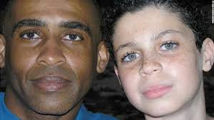
Should you vaccinate the whole family?
Kids should all be
Vaccinated.
Clear evidence of benefit.
Vaccine is safe.
Mom and dad can be vaccinated.
Possible benefit for HPV types they don’t have now but may be exposed to in the future.
Vaccine is safe.
Notes:
I am super proud of my racially ambiguous family– the child is even gender ambiguous!

Slide 21
Will insurance cover vaccination for ages 27-45?
It is probably NOT covered right now
Coverage will depend on ACIP vote
Coverage may be delayed until publication of a new recommendation
If Category B recommendation (individual decision-making), ACA mandates insurance coverage, though some issues can persist

Slide 22
In summary
Vaccination of kids is MOST IMPORTANT and will prevent many cancers
Clear evidence of prevention of pre-cancers and cancers
Vaccination of adults is an INDIVIDUAL DECISION (pending ACIP recommendation)
Limited evidence of benefit

Slide 23
Other questions?

Slide 24
hpvroundtable.org

