Slide 1

Partner Showcase:
American Cancer Society
Mission: HPV Cancer Free

Slide 2
Matt Allison, Senior Program Manager
HPV Vaccination

Slide 3

We are not just building a campaign
Notes:
The week of June 8th, t the American Cancer Society is launching a major national public health campaign to be HPV Cancer Free.
But we’re not just building a campaign -

Slide 4
We are building a movement. . .
Notes:
We are indeed, seeking to build a movement -

Slide 5
Building a Campaign to Eliminate HPV Cancers
Notes:
May want to share this resource overview of the campaign for in-person meetings
https://www.mysocietysource.org/sites/HPV/ResourcesandEducation/Lists/Clearinghouse/Attachments/627/Mission%20HPV%20Cancer%20Free%20Overview%20-%20External.pdf

Slide 6
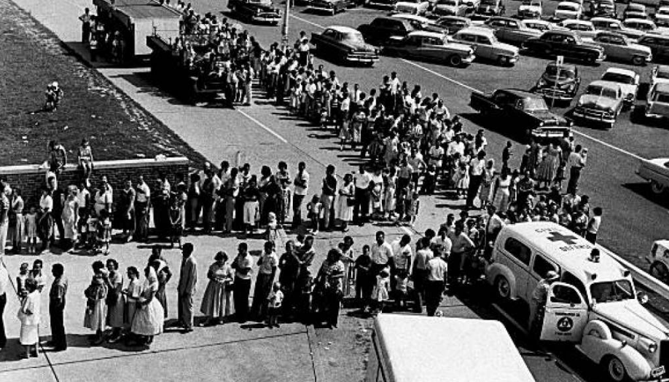
1959
Notes:
This is a picture of people awaiting polio shots at Evansville's Municipal Stadium in 1959. This line was still four hours long after the clinic started, when this picture was taken.
During the eight-hour program, about 14,000 from Evansville and surrounding communities received shots.
That’s the type of movement we want to build around HPV vaccination.

Slide 7
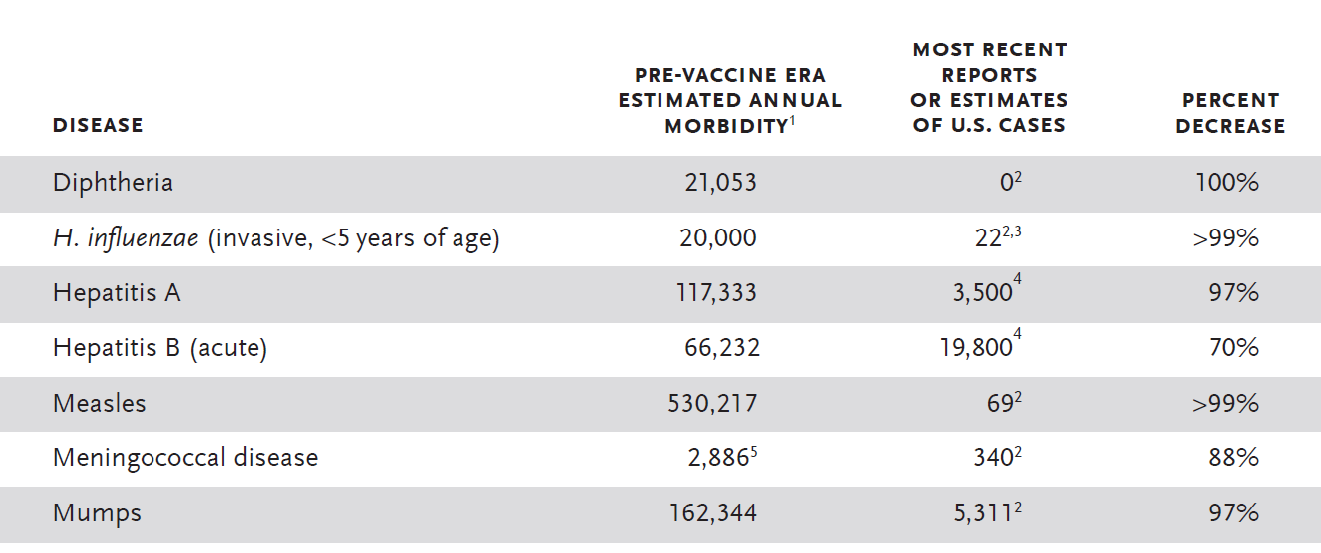
Vaccines Work.
Notes:
People lined up for the polio shot because they knew then, what we know now – that vaccines work.
You can see the impact vaccines have had on preventable diseases from this CDC data.
People wanted to prevent polio and its devastating effects, just the same as they wanted to prevent measles, mumps, and hepatitis.
Well we want people to want to prevent Cancer too.

Slide 8
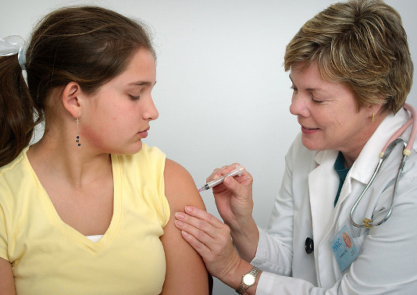
OUR GOALS:
Increase routine HPV vaccination rates for preteens
Eliminate gender disparity and reduce geographical disparities in HPV vaccination
Notes:
The goals behind our movement are simple:
Increase routine vaccination rates for preteens.
And
Eliminate the current gender and geographical disparities in vaccination.

Slide 9

OUR OBJECTIVES
1. Increase routine HPV vaccination rates for preteens
  Increase national HPV vaccination series completion rate among 13-year-olds to at least 80% by June 8, 2026
  Increase each state’s HPV vaccination series completion rate among 13-17-year-olds to their rate of Meningococcal vaccination among 13-17-year-olds by June 8, 2026
2. Eliminate gender disparity and reduce geographic disparities in HPV vaccination
  Increase male HPV vaccination series completion rate among 13-year-olds to that of females in each state by June 8, 2026
  Increase HPV vaccination rates in geographic locations lagging behind the national average
Notes:
The objectives behind these goals are really exciting –
As an organization, and with those partners who join us – we are aiming to
Increase the National HPV Vaccination completion rate among 13-year-olds to at least 80% by June 8, 2026.
And increase each state’s completion rate among 13-17 year olds to the rate of their meningococcal vaccination rate by that same date.
---Does anyone here know the significance of June 8, 2026? …. Pause…. That’s the 20 year anniversary of this vaccine – we should be able to do this. We need to.
Additionally, we’re aiming to increase male series completion rate to that of females in each state. And increase rates in geographically disparate locations falling behind the national average.

Slide 10
OUR STRATEGIC AUDIENCES
Health systems and providers
Parents
Staff
Volunteers
Key Partner Organizations
Donors
Notes:
The ACS audiences are just about everyone we come in contact with –
We have nearly 5,000 staff who following an internal launch of this campaign in November have been brushing up on their understanding of the topic and planning how they can make an impact through their relationships – whether they plan and host a gala, manage a Relay for Life event, or work in our legal department.
Not to mention, how we can have an impact through our over 2 million volunteers.
The American Cancer Society is going all in on this… and I’d like to talk a bit more about how you can join us….

Slide 11

Campaign Messages
HPV vaccination is cancer prevention.
The HPV vaccine series is best when given at age 11 & 12.
The vaccine is safe & effective.
The vaccine is for boys & girls.
Notes:
We have partners who want to help. Who are asking, What Can We Do? How do we share the great work we are already doing. Based on the science, we at ACS are adopting 5 key strategies I will outline next.
Staff Note: Detailed Handout of 5 strategies can be found here:
https://www.societysource.org/Resource_Center/5%20Key%20HPV%20Vaccination%20Strategies.pdf

Slide 12
5 Key HPV Vaccination Strategies

Slide 13
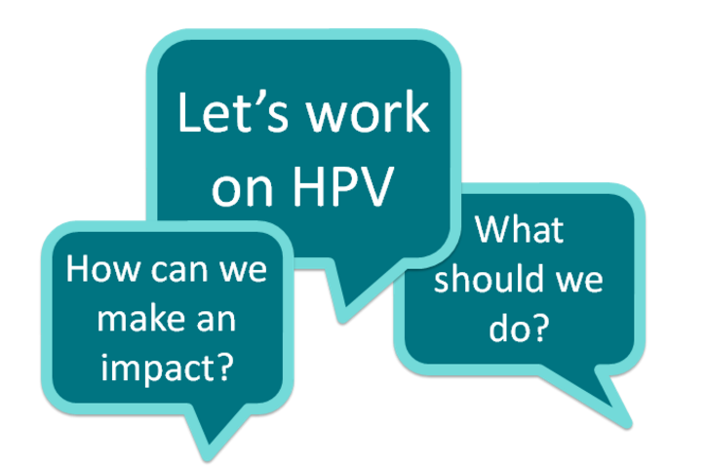
Notes:
We have partners who want to help. Who are asking, What Can We Do? How do we share the great work we are already doing. Based on the science, we at ACS are adopting 5 key strategies I will outline next.
Staff Note: Detailed Handout of 5 strategies can be found here:
https://www.societysource.org/Resource_Center/5%20Key%20HPV%20Vaccination%20Strategies.pdf

Slide 14
Strategy 1:
Strengthen
Provider Recommendations
Notes:
The biggest predictor of HPV vaccination uptake is an effective recommendation from a health care professional so we are partnering with providers and health systems to make sure that health care professionals are making a strong, effective recommendation.

Slide 15
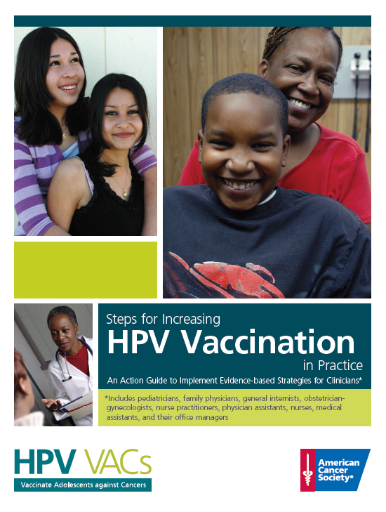
Steps for Increasing HPV Vaccination in Practice:
An Action Guide to Implement Evidence-based Interventions in Clinical Practice
http://bit.ly/HPVStepsActionGuide
Toolkit+
Road map
Portal to resources
Launched June 2015
Tested and improved by over 80 FQHC clinic-level intervention projects
Notes:
Here is an example of one of many resources that we use within a clinical system to help support HPV vaccination efforts.
http://bit.ly/HPVStepsActionGuide
8 pages
Created by the American Cancer Society with contributions by Noel Brewer and Rebecca Perkins.
Initial Audience: HPV VACs pilot FQHCs

Slide 16

HPV Roundtable Clinical Action Guides
The guides available include:
Physician/Physician Assistant/Nurse Practitioner Guide
Nurse & Medical Assistant Guide
Dental Health Professionals Guide
Large Health Systems Guide
Office Team Guide
Small Private Practices Guide
Notes:
Here is an example of one of many resources that we use within a clinical system to help support HPV vaccination efforts.
http://bit.ly/HPVStepsActionGuide
8 pages
Created by the American Cancer Society with contributions by Noel Brewer and Rebecca Perkins.
Initial Audience: HPV VACs pilot FQHCs

Slide 17
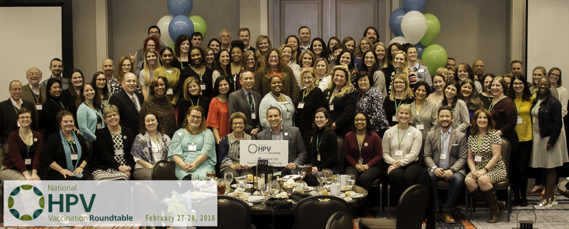
Strategy 2: Activate Partners and Stakeholders
Notes:
Each state, community, and jurisdiction has its own set of challenges, opportunities, and systems to tackle to improve HPV vaccination rates. In many states, forming key stakeholder groups such as a state HPV vaccination roundtable or coalition is integral to improving rates. Regardless of whether a state group is a formal roundtable or an informal coalition, there are key members that should be working together.

Slide 18
Strategy 3:
Know Your Data and Track Progress
Notes:
ACS Health Systems staff can help with understanding HPV data. Whether at a clinic, county, or state level, data can help drive your planning and intervention process.

Slide 19
Strategy 4:
Implement Evidence-Based Interventions and Systems Changes
Notes:
Targeted interventions are needed to ensure timely progress. Systems changes should be made, as necessary, to support and sustain HPV vaccination interventions. Evidence-based interventions for HPV vaccination include patient reminders, provider EHR alerts, standing orders, provider feedback reports, and policy changes.

Slide 20
Strategy 5:
Increase Parental Knowledge
Notes:
Our #1 message is that HPV vaccination is cancer prevention. Communicating this message within ACS, with parents, and with our partners will help us make HPV cancers history.

Slide 21

External launch week of June 4, 2018
Notes:
June 8, 2026 will mark 20 years since the original FDA approval of the first HPV vaccine in the United States. The American Cancer Society will be using June 8th as an annual touchpoint and will be launching the external campaign the week of June 8, 2018. As an annual touchpoint, this date will be used to report on ACS’s progress towards our 2026 coverage goal. By Mid-April a promotional kit for this week will be available for ACS staff to use and share with key partners.

Slide 22
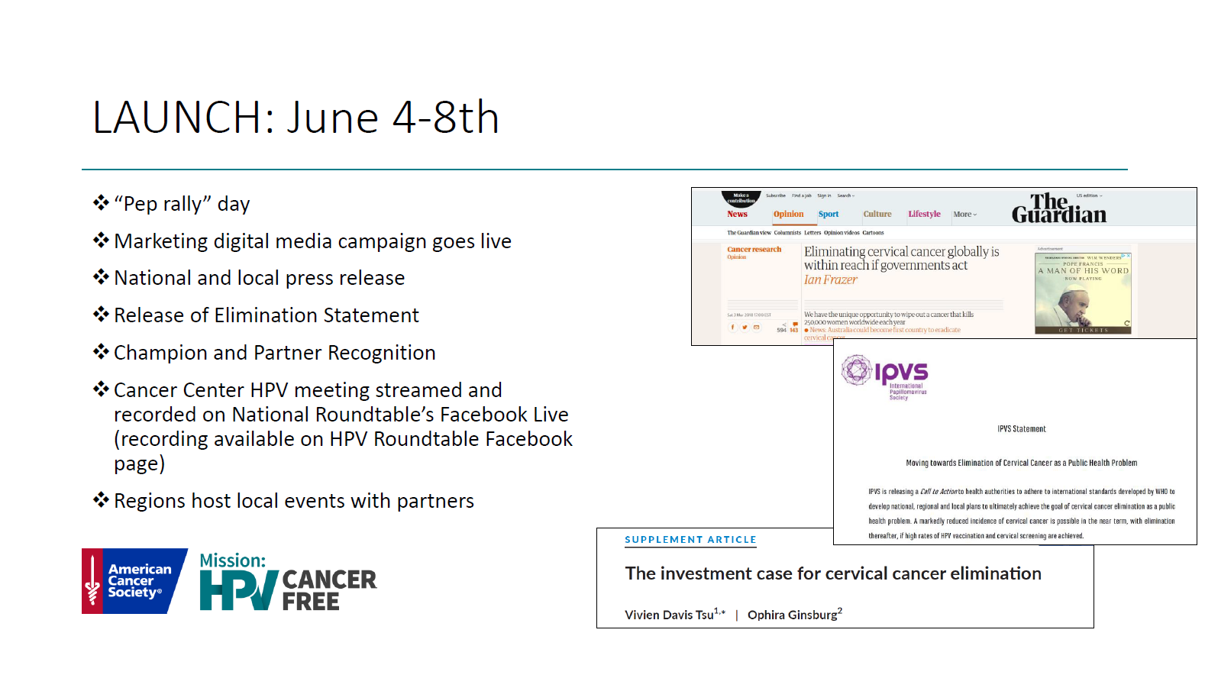

Slide 23
Take action and stand with ACS:
Endorse, share, and support the American Cancer Society goal to vaccinate 80% of 13-year-olds by 2026.
Visit www.cancer.org/HPV and follow and share American Cancer Society social media posts on Facebook, Twitter, and Instagram.
Partner with the American Cancer Society on the five key campaign strategies.
Join existing HPV coalitions, roundtables, or workgroups. These groups are planning and leading HPV vaccination improvement work across their state. Their plans and activities can be shared by your local ACS State Health Systems manager. To identify and contact the ACS State Health Systems staff partner for your state, access our interactive map.

Slide 24
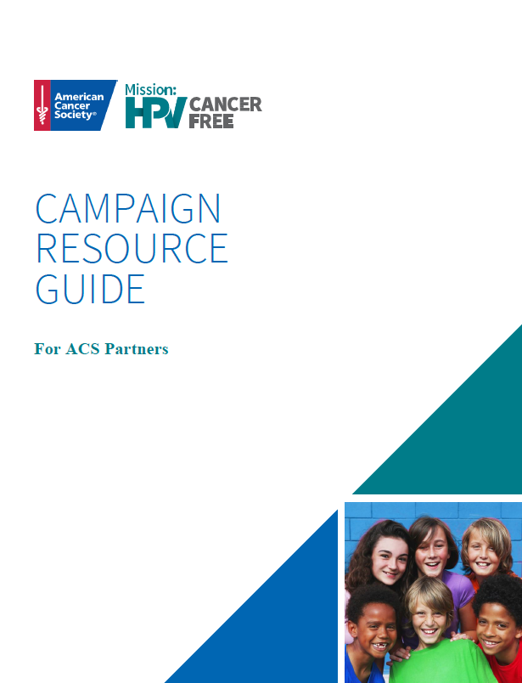
Campaign Resource Guide
This Guide contains ready to use resources to help your team or organization share positive messages about HPV cancer prevention and vaccination

Slide 25

This guide contains ready to use resources and links to help your team or organization share positive messages about HPV cancer prevention and vaccination all summer long.
We invite and encourage all our partners to stand with ACS and encourage parents and providers to vaccinate their children with the HPV vaccine.

Slide 26
Includes:

Slide 27
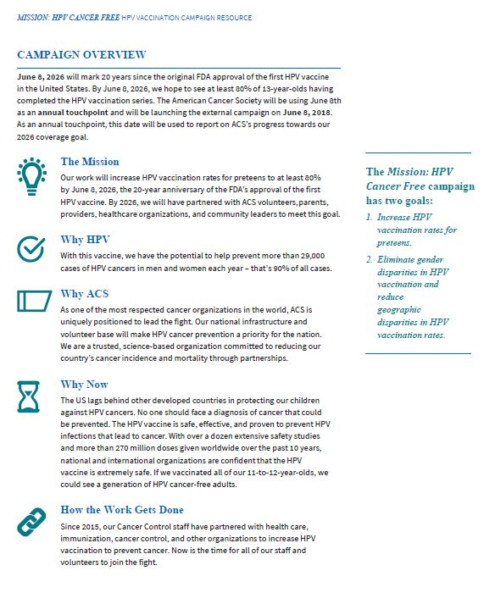
Overview of ACS campaign
Descriptions of the 5 key campaign strategies
Launch Timeline
Sample Blog Post/Op-Ed
Resources for Clinicians and Healthcare Professionals
Resources for Parents
Call to Action

Slide 28




Overview of ACS campaign
Descriptions of the 5 key campaign strategies
Launch Timeline
Sample Blog Post/Op-Ed
Resources for Clinicians and Healthcare Professionals
Resources for Parents
Call to Action
Videos
CME and e-Learning
Hold Scripts
Fact Sheets

Slide 29
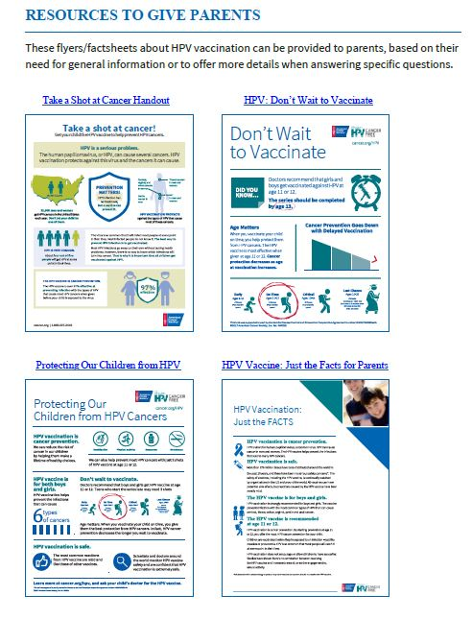
Overview of ACS campaign
Descriptions of the 5 key campaign strategies
Launch Timeline
Sample Blog Post/Op-Ed
Resources for Clinicians and Healthcare Professionals
Resources for Parents
Call to Action

Slide 30
Call To Action
Endorse, share, and support the ACS goal to vaccinate 80% of 13-year-olds by 2026.
Visit www.cancer.org/HPV and follow and share ACS social media posts on Facebook, Twitter, and Instagram.
Partner with ACS on the five key campaign strategies.
Join existing HPV coalitions, roundtable, or workgroups.

Slide 31
When we stand together,
we can make HPV cancer history.

Slide 32
Questions?
Contact Us:
Matt.Allison@Cancer.org
cancer.org | 1.800.227.2345
©2017 American Cancer Society, Inc. No. 080310. Models used for illustrative purposes only.

